Slide 1
Intro to Lightning Components
… and replacing JavaScript Custom Buttons
Doug Ayers
Salesforce MVP
Senior Developer, GearsCRM
@DouglasCAyers
douglascayers.com

Slide 2

Lightning, Lightning, Lightning
What is Lightning Experience?
What is Lightning Design System?
What are Lightning Components?
Why are JavaScript buttons not supported?
Demo: Update Multiple Records from List View
Demo: Call Apex Class
Demo: Pre-Populate Form Field Values

Slide 3




Lightning Experience
Lightning Design System
Lightning Components

Slide 4

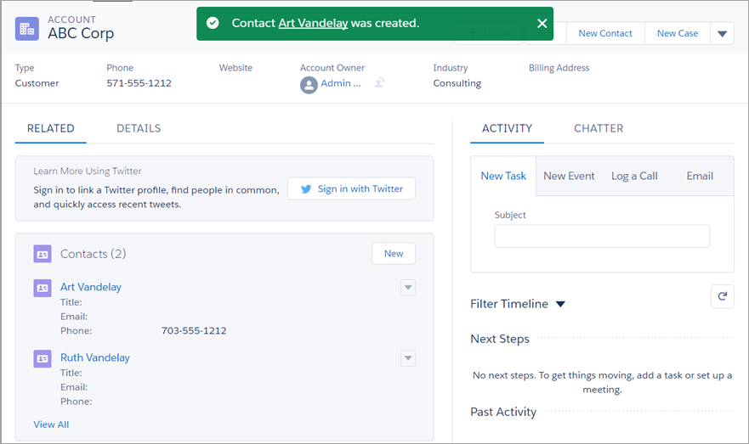

Lightning Experience
The new, fast, beautiful user experience from Salesforce
Enabled by Administrator
Permission Based Rollout
Responsive Design: Mobile & Desktop
Smarter CRM for Sales & Service
https://trailhead.salesforce.com/en/trail/lex_dev

Slide 5
Lightning Experience
Lightning Design System
Lightning Components

Slide 6
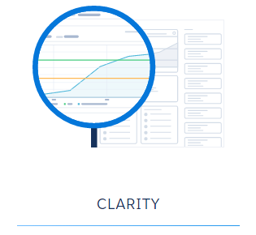
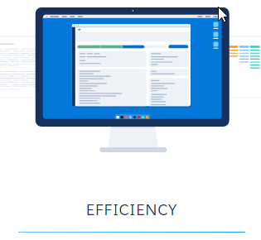
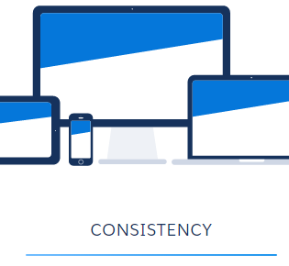
Salesforce Lightning Design System (SLDS)
www.lightningdesignsystem.com
Components and guidelines for creating unified Salesforce UI
Pure CSS Framework, No built-in JavaScript support
Available in or out of Salesforce
Responsive Design: Mobile & Desktop

Slide 7
Lightning Experience
Lightning Design System
Lightning Components

Slide 8
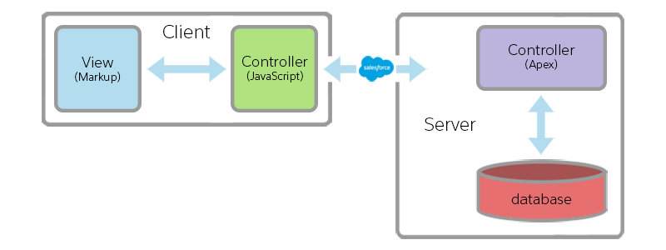
Lightning Components
The new SPA component-based development framework from Salesforce
Not replacing Visualforce
Stateless on server (Apex), Stateful on client (JavaScript)
Auto re-renders after client-side data changes
Loosely-coupled, Event-driven
App centric vs. Page centric
https://trailhead.salesforce.com/en/lex_dev_lc_basics/lex_dev_lc_basics_intro

Slide 9
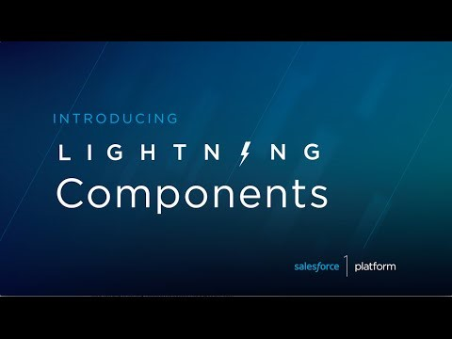
Lightning Components

Slide 10

On-Click JavaScript Buttons and Lightning Experience
Insecurity of inline JavaScript from multiple untrusted sources
JavaScript has full access to DOM to add, change, or delete anything
Extremely useful, but extremely vulnerable to Cross-Site Scripting attacks
Lightning LockerService introduced to mitigate and prevent risks
The risks outweigh the benefits
Suitable alternatives exist:
Quick Actions
Visualforce
Lightning Components
https://developer.salesforce.com/blogs/developer-relations/2016/09/why-its-time-to-break-up-with-javascript-buttons-and-embrace-lightning.html
http://www.slideshare.net/developerforce/javascript-security-and-lightning-locker-service

Slide 11
Demos!
Notes:
1. Create “Salesforce Migration ID” External ID in target org
2. Export Accounts, Contacts, and Opportunities from source org
3. Upsert Accounts, Contacts, and Opportunities into target org

Slide 12

Next Steps
Never stop learning because life never stops teaching
Trailhead: Develop for Lightning Experience
Blog Series: Creating Lightning Components (Don Robins)
Video Course: Creating Lightning Components (Don Robins)
Video: Developing Lightning Components (Thomas Crouse)
Videos: Mastering Lightning Framework – Part 1 & Part 2 (TrailheaDX)
Video: Building Lightning Components (Christophe Coenraets)
Video: Build Apps Faster with Lightning (Christophe Coenraets, Greg Rewis)
Video: Advanced Designs for Reusable Lightning Components (Tom Waud)
Video: Getting Started with Lightning Components (Sara Morgan)

